Slide 1


Availability-Performance testing to any website all over the world
John pourdanis

Slide 2
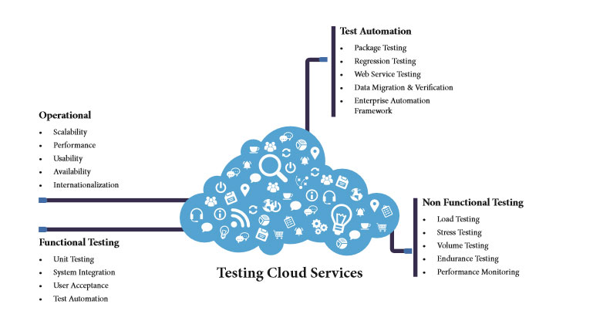
Why select cloud services for testing?

Slide 3
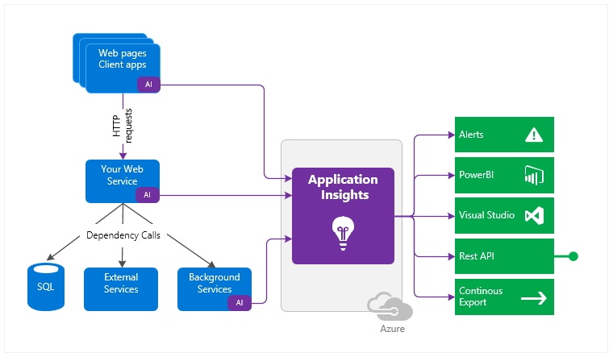
Why Application Insights?

Slide 4
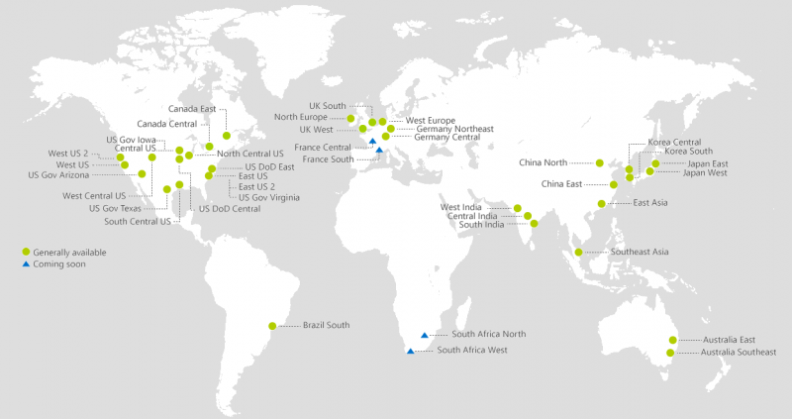
Microsoft Azure regions

Slide 5
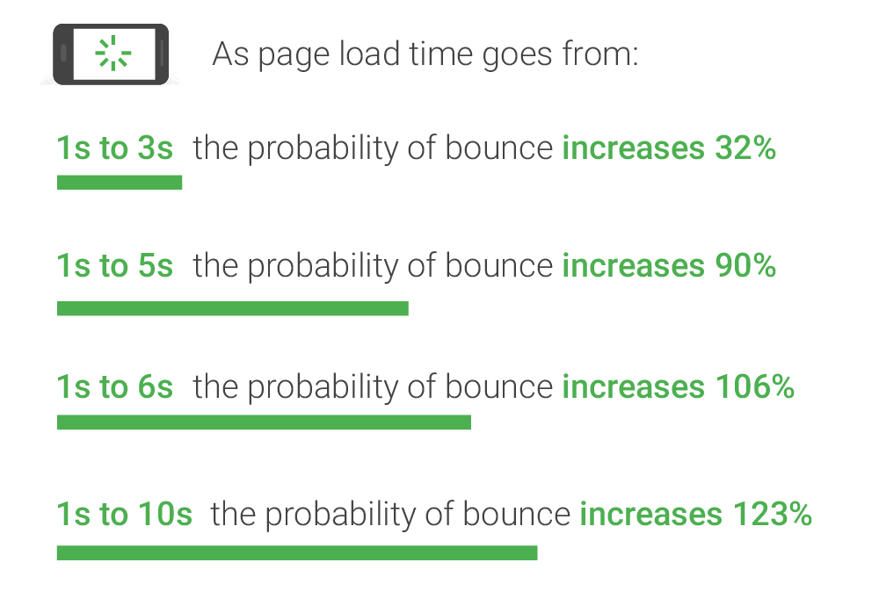
Does performance matter?

Slide 6

Performance/Load Testing
Performance testing is usually done to help identify bottlenecks in a system or to establish a baseline for future testing. It is also done to ensure compliance with performance goals and requirements, and to help stakeholders make informed decisions related to the overall quality of the application being tested.
What does it check?
Speed - Determines whether the application responds quickly
Scalability - Determines maximum user load the software application can handle.
Stability - Determines if the application is stable under varying loads

Slide 7
Availability Testing
Applications in the modern world rely and depend on multiple servers, internal and external network communications, database services, operational processes, and a host of other infrastructure services that must all work uniformly and together. Here, the business ideal is a continuous flow of information — and any interruption costs the company money; hence, creating high-availability applications becomes an important business strategy.
As a general idea, availability is a measure of how often the application is available for use. More specifically, availability is a percentage calculation based on how often the application is actually available to handle service requests when compared to the total, planned, available runtime. The formal calculation of availability includes repair time because an application that is being repaired is not available for use.

Slide 8
How we count Availability of a website
Mean Time Between Failure :
Average length of time the application runs before failing.
Mean Time To Recovery :
Average length of time needed to repair and restore service after a failure.
Parameter | Acronym | Calculation
Mean Time Between Failure | MTBF | Hours / Failure Count
Mean Time To Recovery | MTTR | Repair Hours / Failure Count
Availability = (MTBF / (MTBF + MTTR)) X 100

Slide 9
The tricky part of “Nines”
For example, consider an application that is intended to run perpetually. If we assume 1000 continuous hours as a checkpoint, two 1-hour failures during that time would result in availability of ((1000/2) / ((1000/2) + 1)) X 100 = (500 / 501) X 100 = .998 X 100 = 99.8%.
One popular way to describe availability is by the “nines,” such as three nines for 99.9% availability. However, the implication of measuring by nines is sometimes misunderstood. You need to do the arithmetic to discover that three nines (99.9% availability) represents about 8.5 hours of service outage in a single year. The next level up, four nines (99.99%), represents about 1 hour of service outage in a single year. Five nines (99.999%) represents only about 5 minutes of outage per year.

Slide 10
The example of Netflix
Currently, Netflix uses a service called “Chaos Monkey” to simulate service failure. Basically, Chaos Monkey is a service that kills other services. We run this service because we want engineering teams to be used to a constant level of failure in the cloud. Services should automatically recover without any manual intervention. We don’t however, simulate what happens when an entire AZ goes down and therefore we haven’t engineered our systems to automatically deal with those sorts of failures. Internally we are having discussions about doing that and people are already starting to call this service “Chaos Gorilla”.

Slide 11
Reference links
Thank you
https://docs.microsoft.com/en-us/azure/application-insights/app-insights-monitor-web-app-availability
https://www.qualitestgroup.com/white-papers/introduction-availability-testing/
https://medium.com/netflix-techblog/lessons-netflix-learned-from-the-aws-outage-deefe5fd0c04

